Slide 1
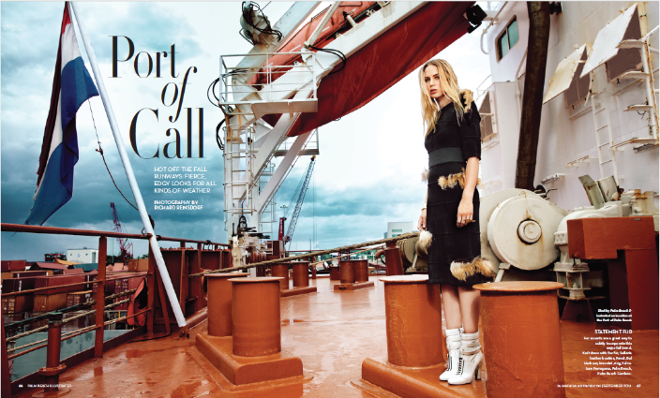
Port of Palm Beach
Palm Beach Illustrated spread
Promotional/Advocacy material
Use this area for logo
(delete text box before placing logo)

